Slide 1

Title: AI StUDENTCAPITAL
Connecting Students with Investors Using AI Powered website
Presenters' Names : SKOSANA T, LESELE KG,
SHILENGE VB, NGWENYA NA,
THOBAKGALE TT, KUNENE PP,
NDLOVU M, KHOZA KP
Date : 28 October 2024

Slide 2
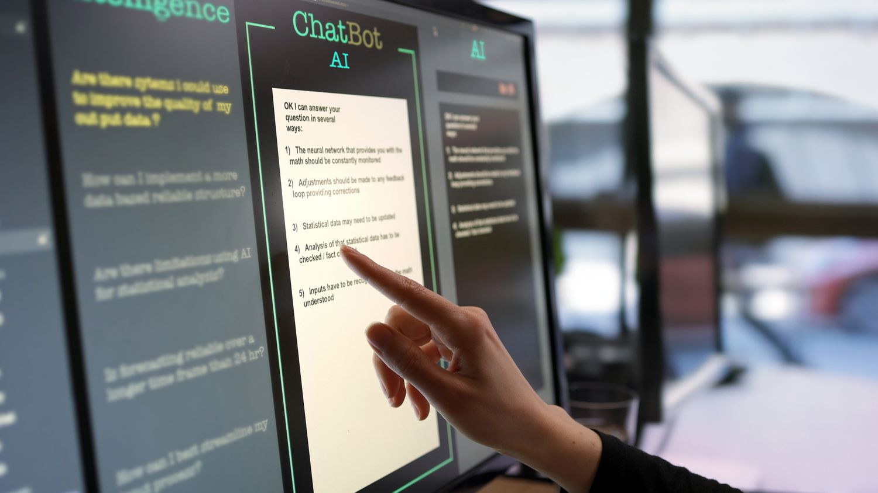
1. Project Overview
AI platform designed to connect students with innovative project ideas to investors.
Leverages AI to match projects with suitable investors based on relevance, industry, and interests.
Streamlines the process, encouraging investment in student innovations.

Slide 3



2. Problem Definition
Students often lack funding and connections for their projects.
Investors struggle to find fresh, innovative projects aligned with their interests.
The disconnect results in missed opportunities for both students and investors.
AI solution aims to bridge this gap by promoting efficient matches.

Slide 4

3. AI Objectives
Automatically match student projects with relevant investors.
Consider factors such as:
Industry focus
Market impact
Investor preferences
Historical success data

Slide 5

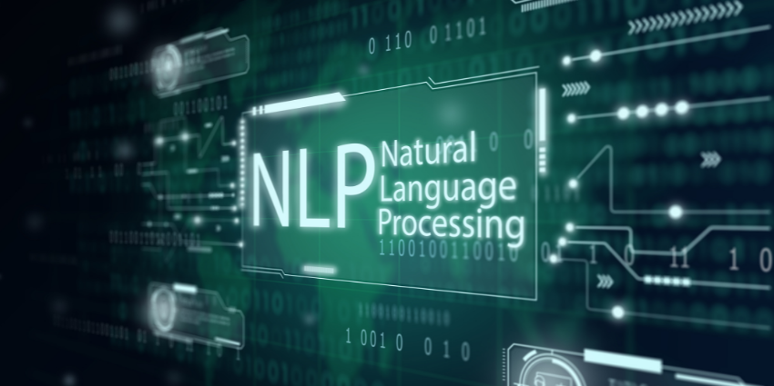
4. Key Features of the AI Solution
Key Features of the AI Solution
a) Project Analysis
Uses Natural Language Processing (NLP) to break down project proposals.
Analyses key aspects like industry, audience, and goals.
b) Investor Matching
Uses machine learning algorithms.
Compares project data with investor profiles based on:
Industry focus
Previous investments
Risk tolerance

Slide 6

4. Key Features of the AI Solution (continued)
c) Recommendation System
AI-powered recommendations for relevant investors.
Sends project pitches to suitable investors.
d) Predictive Success Rating
Assigns a success rating to projects.
Helps investors gauge growth potential and ROI

Slide 7

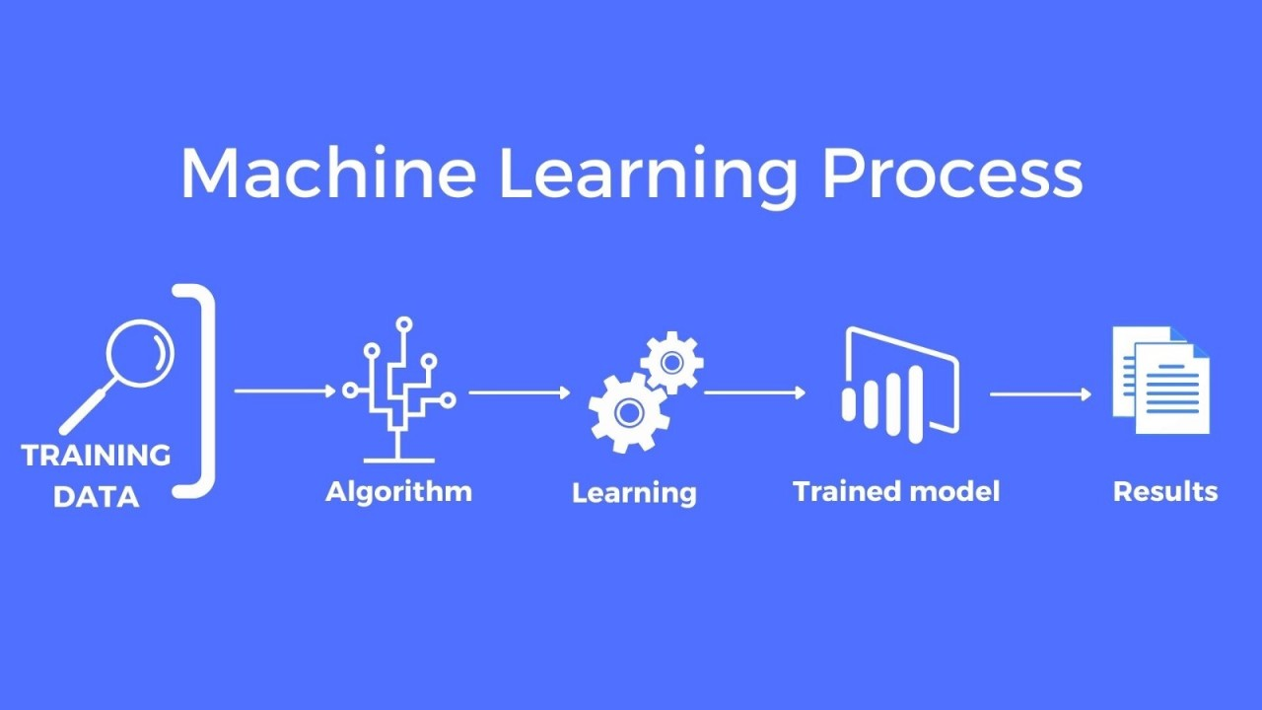
5. Implementation Strategy
Title: Implementation Strategy
Step 1: Data Collection
Collect data from students and investors (project submissions, investor profiles).
Step 2: Model Training
Use machine learning to train the model on successful matches.
Step 3: NLP for Project Understanding
Extract key information like market potential, innovation type, and feasibility.

Slide 8
5. Implementation Strategy (Continues)
Title: Implementation Strategy
Step 4: Machine Learning for Matching
Develop an algorithm (k-NN, Decision Trees) for matching projects with investors based on multiple factors.
Step 5: System Integration and Testing
Test the platform for relevance and refine the algorithm with feedback.

Slide 9
6. Tools and Technologies
Title: Tools and Technologies
‘
Programming Language: Python
Frameworks: Flask/Django for backend, Scikit-learn/TensorFlow for machine learning
NLP Libraries: Spacy/NLTK
Database: SQL/NoSQL
Cloud Platforms: AWS/Google Cloud

Slide 10
7. Benefits of the AI Platform
Title: Benefits of the AI Platform
Efficient Matching: Faster connections between students and investors.
Improved Investment Decisions: Investors receive success ratings.
Promotion of Innovation: Students access funding, encouraging more creativity.

Slide 11
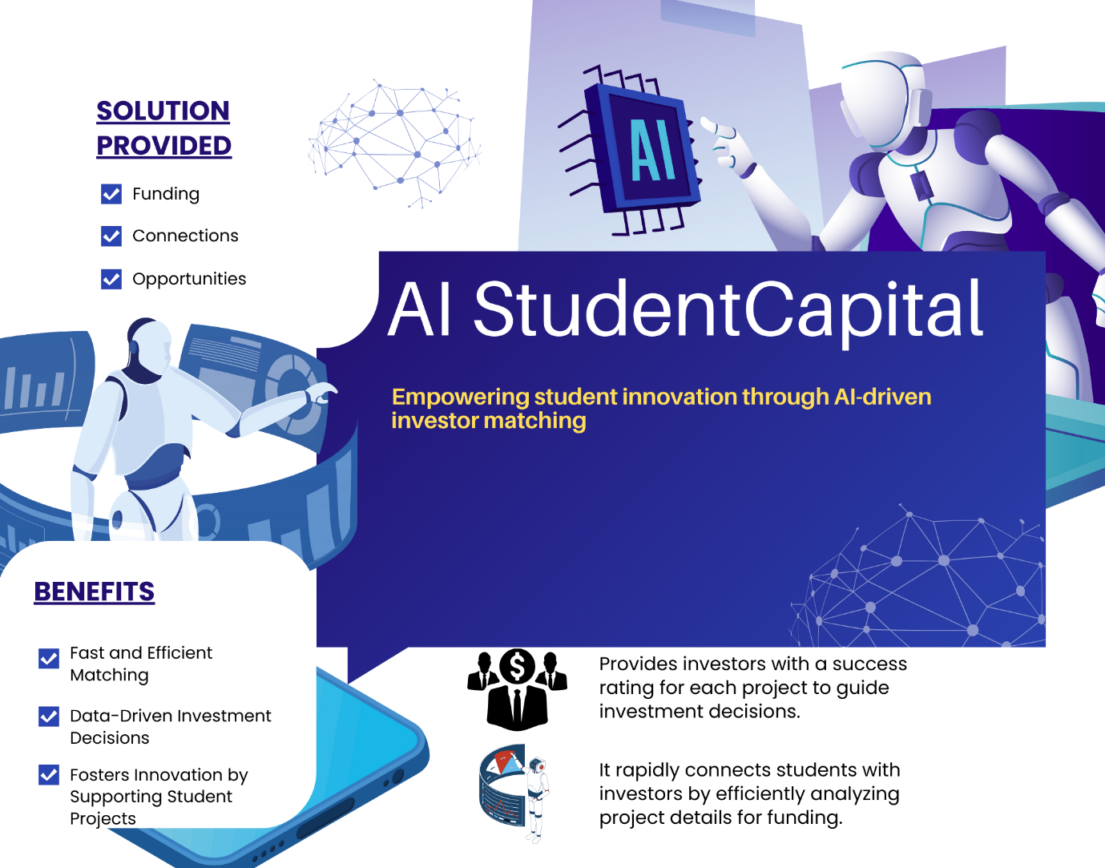
8. Poster

Slide 12
9. Conclusion
The AI platform bridges the gap between students and investors.
Automates the matching process and provides valuable insights.
Encourages investment in student projects, fostering innovation

Slide 13
Questions ?

